Slide 1
Capstone Final Project
August 13, 2020

Slide 2
Introduction
Chennai city continues to expand in terms of size by including newer zones and by population by migrants
Need to improve the healthcare infrastructure
Local administration has engaged a professional Data Scientist to help them arrive at the possible location for new healthcare facility

Slide 3
Problem statement
With many zones in the city and population spread across, where should we plan for the upcoming healthcare facilities
Consider factors like population, air quality, water quality, number of households in the analysis

Slide 4
Data Acquisition & Cleansing
Some basic data has been obtained in excel format from Greater Chennai Corporation administration
Since the city is still in the process of digitizing various of their data, for the purpose of this project and its analysis, data related to air quality, water quality and households have been simulated.

Slide 5
Analysis
The problem and the data do not lend to Regression analysis
Clustering approach has been followed to group and study the clusters.
K-Means cluster analysis was performed for different values of k
Distortions were plotted for different values of k, to arrive at the ‘elbow’ point – optimum value of k

Slide 6
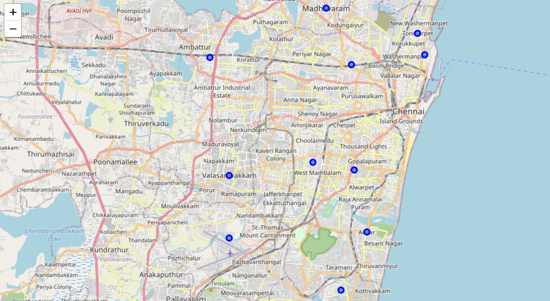
Geolocator was used to get the zone’s latitude and longitude data.
Foursquare has not been functioning for a long time.

Slide 7
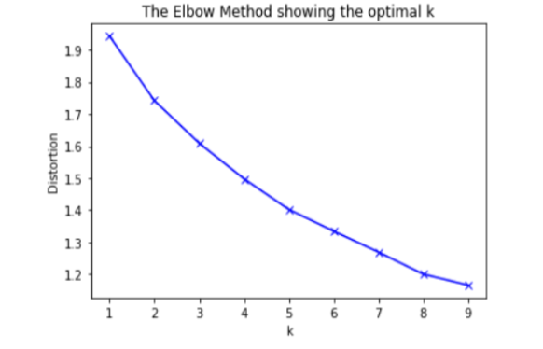
Analysis
Visual inspection reveals, a clear ‘elbow’ point is not arrived at.

Slide 8
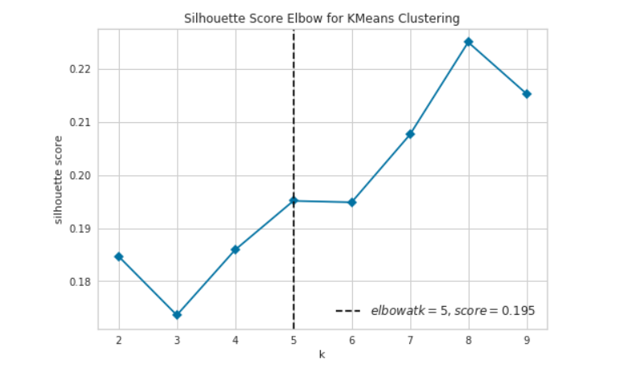
Analysis
Silhoutte score was derived for arriving at the optimal k-value, as 5

Slide 9
Results
The top 3 zones have been arrived at and they are as follows:
Adyar
Annanagar
Royapuram

